Slide 1
ChatDB
Proposal of a project in response to the task ‘Talk to your data’

Slide 2
Introduction
ChatDB is a web app that revolutionizes the way in which you interact with your databases.
Use voice commands, ChatDB will suggest which SQL query you have in mind.
Accept, or edit, the generated SQL query. ChatDB will return you the tables that you were looking for.

Slide 3
Demo
A demo (in polish) is available here: https://drive.google.com/file/d/1C9Y8L_vffM--bxwOv-IAZLsJQONMmSpR/view?usp=sharing
The model does not work as fast as seen on the demo, where we cut out the process of loading the answer.

Slide 4
Test Query

Slide 5
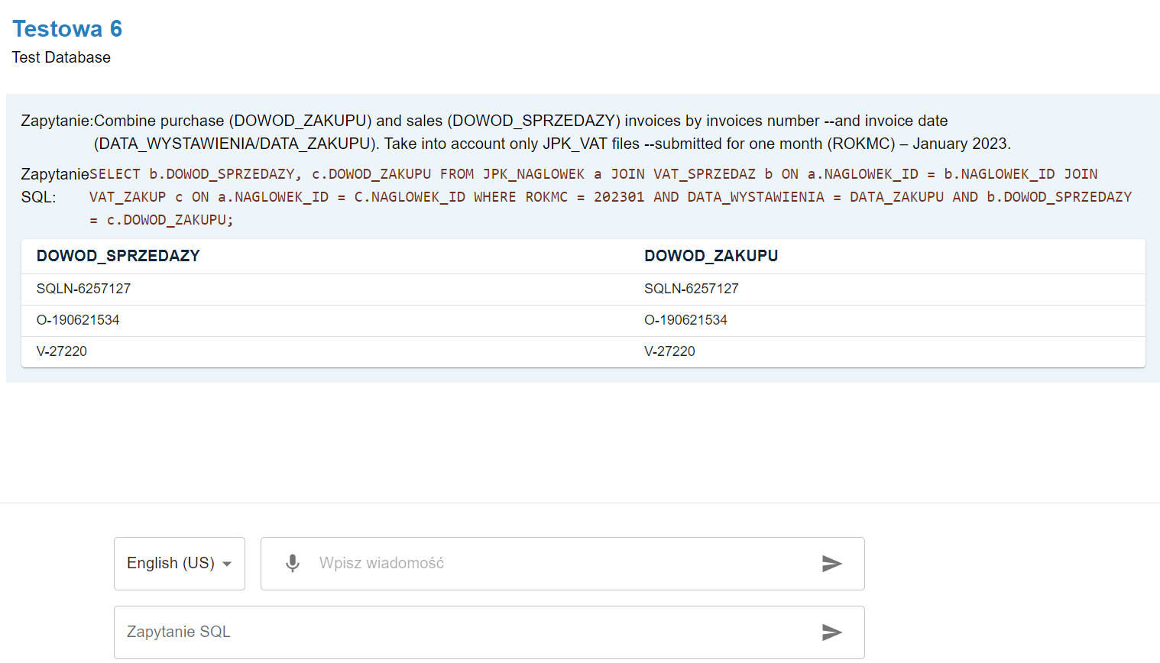
Test Query

Slide 6
Requirements met
The app works fully locally
We use open source solutions, with Apache 2.0 licence, which allows for commercial use.
Adjustable to any database structure. You can define it using DDL or ChatDB can read the structure straight from the connected database
The app has a polish and an english interface. You can talk with the database in polish and in english
The app is deployed using docker container solutions.

Slide 7
Additional functionality + scaling
Implemented a connection with a database via URL. The app automatically reads the database structure from the connected database.
Our text-to-SQL model uses Machine Learning. The model can be fine-tuned using custom data (for example, the data derived from users editing the queries). The model learns from its own mistakes.

Slide 8
Information about the model
The model we used is nsql-llama-2-7B. You can find information about it on the website: https://huggingface.co/NumbersStation/nsql-llama-2-7B
The python requirements are available in the requirements.txt file.

Slide 9
Installation instruction
Download the code from the repo: https://github.com/Konex25/ChatDB
Download the model from the website: https://huggingface.co/NumbersStation/nsql-llama-2-7B
Put the model files in the location: TalkToYourData/text2sql/nsql-llama-2-7B
Run from the repo home location:
docker build -t ChatDB_image .
After building, run container:
docker run --name ChatDB ChatDB_image

